Slide 1

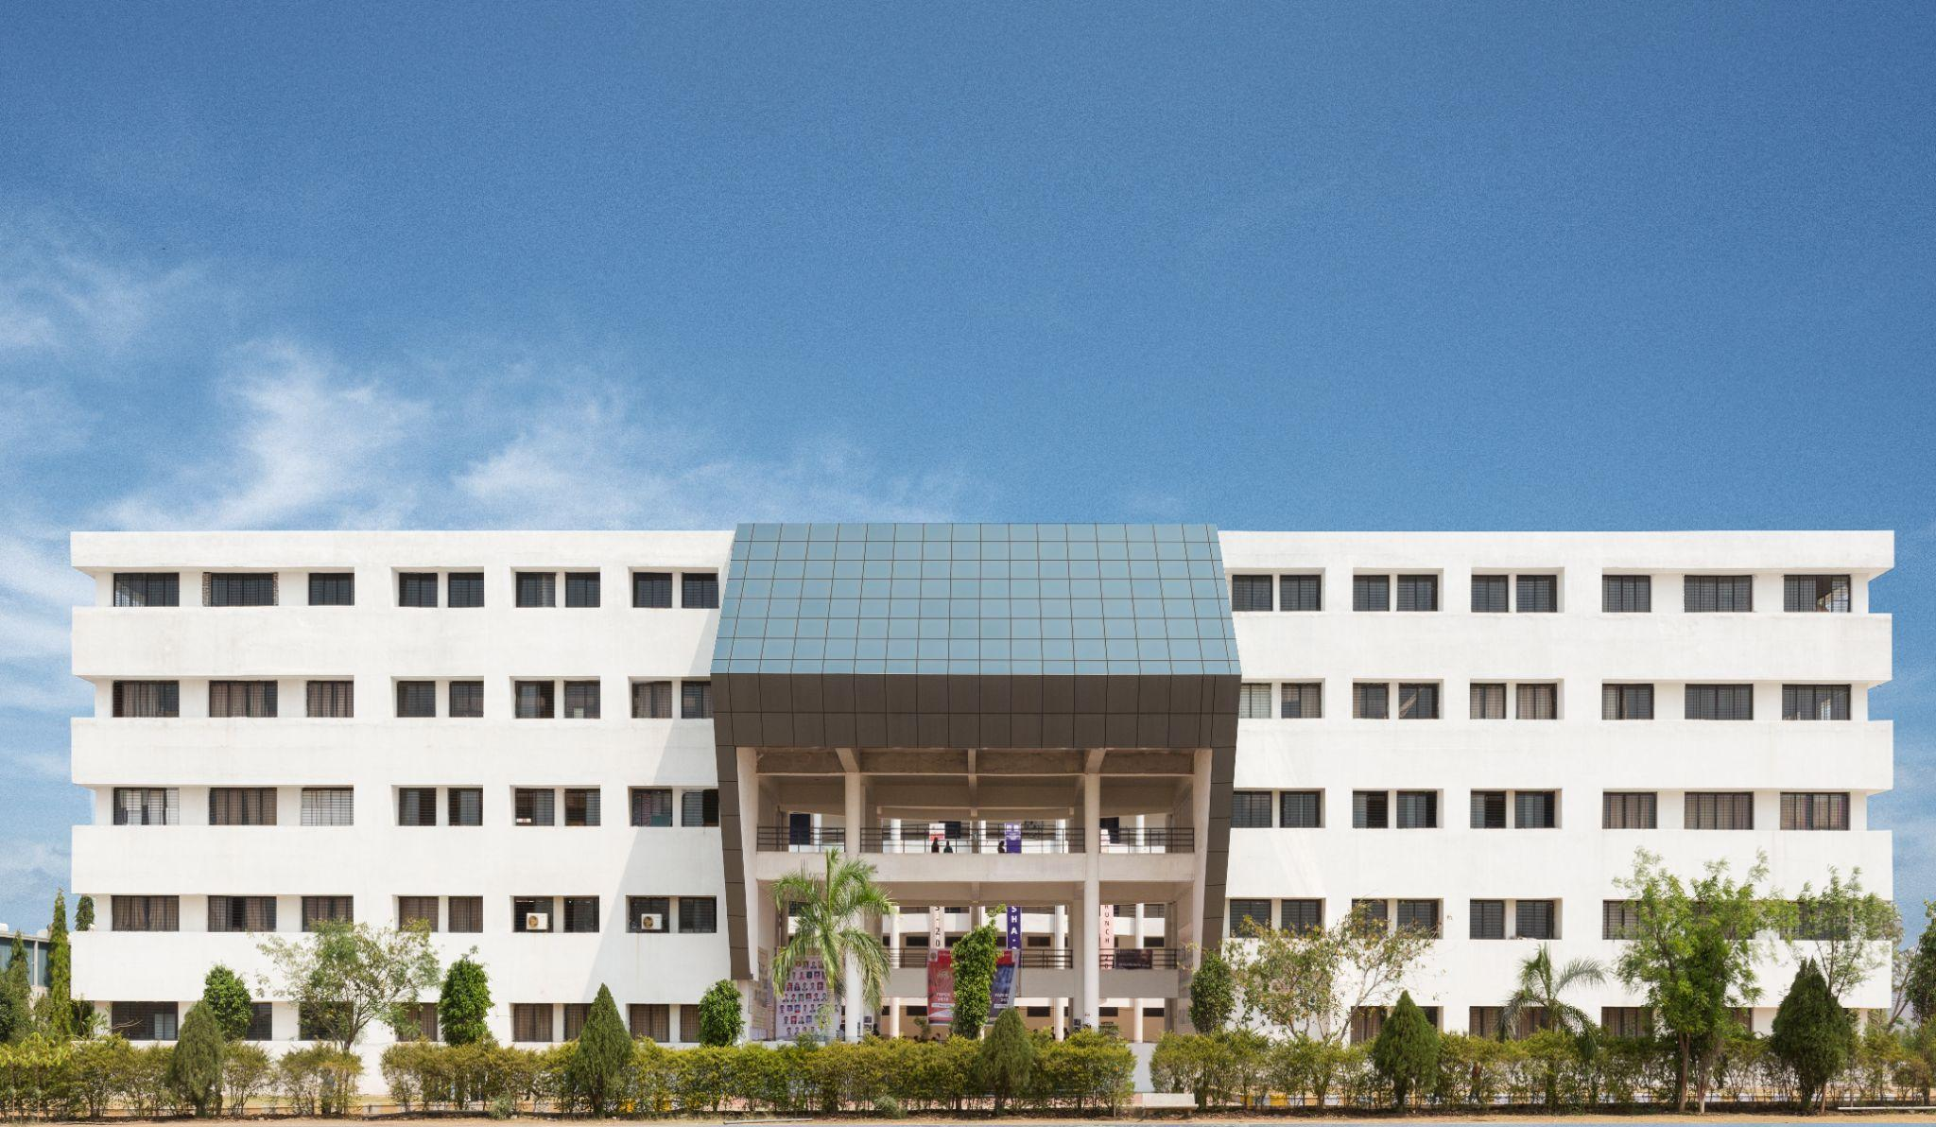


COMPARATIVE ANALYSIS OF MULTISTOREYED STRUCTURE FRAME WITH AND WITHOUT FLOATING COLUMNS

Slide 2

Synopsis presentation on
Title: COMPARATIVE ANALYSIS OF MULTISTOREYED STRUCTURE FRAME WITH AND WITHOUT FLOATING COLUMNS
Submitted For post graduate degree project in Civil Engineering (School of Engineering and Technology)
G H Raisoni University, Amravati
Guided By
Prof. Swati Ambadkar
Presented By:
SYED UMARUDDIN

Slide 3

Outline
Introduction
Review of Literature
Objectives of the Study
Scope and Limitations
Methodology,Tools and Techniques
Expected Results
References

Slide 4

Introduction
In urban areas of India, due to lack space a single frame structure serve
multipurpose functional area such as commercial ,residential, parking etc. ➢
Due to the architecture complexity ground floor sometimes even first floor is use
as a parking area and some lower floor use for commercial complex whereas rest of
top floor serve as residential building. ➢
Hence attempt to study seismic analysis of G+8 frame RCC structure with and
without floating column. ➢
Building analysed in earth quake zone as per IS Cod 1893-2002 with medium soil
,static analysis is done.
Comparative analysis of the result on the basis of base shear and displacement.
StadPro v8i ss6 use for analysis the building structure.

Slide 5
Review of Literature
Lakshmi Chandran et.al.[2016]: according to her” it is safer to provide building
with floating columns in the outer region at the higher levels and for those which
require floating columns at the inner regions are to be provided along the bottom
levels “ ➢
KAVYA N et. al. [2015], studied the seismic behaviour of the RC multistory
buildings with and without floating column and conclude following point
1. The natural time periods obtained from the empirical expressions do not agree with the analytical natural periods. Hence, the dynamic analysis is to be carried out before analyzing these type of structures. And also it can be concluded from the
analysis that the natural time period depends on the building configuration.
2. Lateral displacement increases along the height of the building. There is more
increase in the displacement for the floating column buildings compared with the
regular building.

Slide 6
3. The inter storey drift also increases as the increase in the number of storeys. The storey drift is more for the floating column buildings because as the columns are removed the mass gets increased hence the drift.
4. As the mass and stiffness increases the base shear also increases. Therefore, the
base shear is more for the floating column buildings compared to the conventional
buildings. Hence, from the study it can be concluded that as far as possible, the
floating columns are to be avoided especially, in the seismic prone areas.
A.P. MUNDADA et. al. [2014]: they concluded that provision of floating column is advantageous in increasing FSI of the building but is a risky factor and increases the vulnerability of the building.
PRATYUSH MALAVIYA et. al. [2014]: He concluded that in the framed structure with no floating columns the nodal displacements is minimum with uniform distribution of stresses at all beams and columns. As a result it is most economical.
SABARI S et. al. [2014]: is concluded that by increasing the column size the
maximum displacement and inter storey drift values are reducing.

Slide 7
Objectives of the Study
The main purpose of this project to study of comparison of G+8 multi-storeyed
frame structure with and without floating column
In this project we analysis on 3 model of structure frame with and without floating
column in seismic zone by equivalent static analysis method
Comparative result taken by base shear and displacement of the frame structure

Slide 8
Scope and Limitations
The floating columns is used for the purpose of architectural view and site situations.
The provision of floating columns can be stated as most of the buildings in India are
covering the maximum possible area on a plot within the available bylaws.
The structural analysis is based on engineering mechanics, mechanics of solids, laboratory
research, model and prototype testing, experience and engineering.
Since balconies are not counted in the floor space index(FSI).

Slide 9
Methodology, Tools and Techniques
Methodology is the systematic, theoretical analysis of the methods applied to a
field of study. It comprises the theoretical analysis of the body of methods and
principles associated with a branch of knowledge.
In this work three G+8 RC frame three dimensional model are selected with and
without floating column. This typical rectangular building is taken having
dimension of 20m x24m. With height of 30m
Following is detail data of RC frame structure
o Zone V
o Zone factor 0.36
o Soil type medium soil
o Importance Factor 1.0
o Response Reduction 5
o Damping Ratio 0.05
o Structure type RC Frame
o Foundation depth 3m

Slide 10
Expected Results
The frame used for this study is a 9 (G+8) storey, structures. The typical floor height is 3 m with
a total 27 m and foundation height consider 3m. In plan, the sides span 24 meter by 20 meter
divided into 4 meter square bays .The results of the comparative analysis between a building
without floating column and with floating column will be carried on the basis of base shear and
storey displacements.

Slide 11
References
1. Shashikant k. Duggal (2013) “Earthquake Resistant Design Of Structure”
Second edition OXFORD university press 2013
2. Pankaj Agarwal Manish Shirshirkhand “Earthquake Resistant Design Of
Structure”
3. Neelam Sharma “earthquake resistant building construction”
Third edition 2015 Published By S.K Khatria And Sons
4. Mr. Gaurav Pandey1, Mr. Sagar Jamle2 “optimum location of floating
column in multistorey building with seismic loading” International
Research Journal of Engineering and Technology (IRJET)
Volume: 05 Issue: 10 | Oct 2018

Slide 12
5. Meghana B .S.1, T.H. Sadashiva Murthy2 “Effect Of Floating Column On The
Behaviour Of Composite Multistoried Building Subjected To Seismic Load” Research
Journal of Engineering and Technology (IRJET)
Volume: 03 Issue: 06 | June-2016
6. E. ANUSHA “Seismic Behaviour Of R.C.C Building With And Without Floating
Columns” NOVATEUR PUBLICATIONS International Journal of Research
Publications in Engineering and Technology [IJRPET]
VOLUME 3, ISSUE 11, Nov. -2017
7. 1. PODILI JYOTHI 2. BOPPUDI BULLI BAB “Design And Analysis
Of High-Rise Building With Floating Columns” (IJITR)
INTERNATIONAL JOURNAL OF INNOVATIVE TECHNOLOGY
AND RESEARCH Volume No.5, Issue No.4, June – July 2017

Slide 13
8. Jayashri Sarode1 and Mr. Amol.S. Pote2. “Analysis Of Floating Column Building
Of Composite And R.C.C Beam Girder & Comparison With R.C.C Frame Structure
By Using Etabs V9.7.0.” Int. J. Adv. Res. 4(8)
9. 1.Deekshitha.R 2. Dr. H. S.Sureshchandra “Analysis Of Multi-Storey Building With
And Without Floating Column” International Journal of Engineering Research &
Technology (IJERT) Vol. 6 Issue 06, June - 2017
10. A.P. MundadaȦ* and S.G. SawdatkarȦ “Comparative Seismic Analysis Of
Multistoreyed Building With And Without Floating Column” International Journal of Current Engineering and Technology, 01 Oct 2014, Vol.4, No.5 (Oct 2014)

Slide 14

Thank You!

